Slide 1

HR Analytics
Arsal Khan
Mandeep Singh
Nikita Mishra
Priyanka Mishra
Supraja Shetty
Uttamkumar Dwivedi
Vaibhavi Parab

Slide 2
Introduction
Objective: Reduce employee attrition by identifying key drivers and implementing actionable strategies.
Context :
Current attrition rate: 50.21% (25,105 employees).
Job satisfaction: 2.49/5, indicating dissatisfaction.
Goal: Improve retention, engagement, and workplace culture.

Slide 3
Key Challenges and Takeaways
Challenges:
Low job satisfaction (2.49/5).
High attrition in key departments and roles.
Non-monetary dissatisfaction among high-income employees.
Gender representation in leadership roles.
Takeaway:
Comprehensive strategies are needed to address these challenges.

Slide 4
Attrition Overview
Key Insight :
Over half(50.21%) the workforce has left the organization.
Low job satisfaction is a major contributor.
Impact :
Organizational instability, increased hiring costs, and loss of institutional knowledge.

Slide 5
Departmental Insights
Departments with Highest Attrition :
Sales: 4,213 employees.
Support: 4,168 employees.
Implications :
High-pressure environments require targeted interventions.
Training and support for managerial roles are critical.

Slide 6
Income vs. Attrition
Insight :
High-income employees exhibit greater attrition rates.
Possible Causes :
Non-monetary dissatisfaction (e.g., culture, leadership).
Lack of meaningful work or growth opportunities.

Slide 7
Role-Specific Insights
Roles with Highest Attrition :
Sales Executives.
Support Staff.
Research Scientists.
Recommendation :
Redesign these roles to reduce stress and repetitive tasks.
Provide growth opportunities and clear career paths.

Slide 8
Gender Perspectives
Male Employees :
Average Income: ₹25,979.
High Attrition: R&D, Sales, Support.
Job Satisfaction: Slightly higher involvement (2.505).
Female Employees :
Average Income: ₹26,052.
High Attrition: Matches male trends.
Observation: Minimal gender pay disparity, but fewer leadership opportunities.

Slide 9
Proposed Solutions
Enhancing Job Satisfaction :
Conduct surveys to identify pain points.
Address workload, work-life balance, and growth opportunities.
Recognize and reward employee contributions.
Targeted Retention Strategies :
Focus on Sales, Support, and R&D departments.
Improve managerial support and career development.
Redesign roles with repetitive tasks.
Address High-Income Attrition :
Offer meaningful work and leadership training.
Implement flexible work arrangements.
Promoting Gender Equity :
Encourage female leadership.
Monitor and address pay disparities.

Slide 10
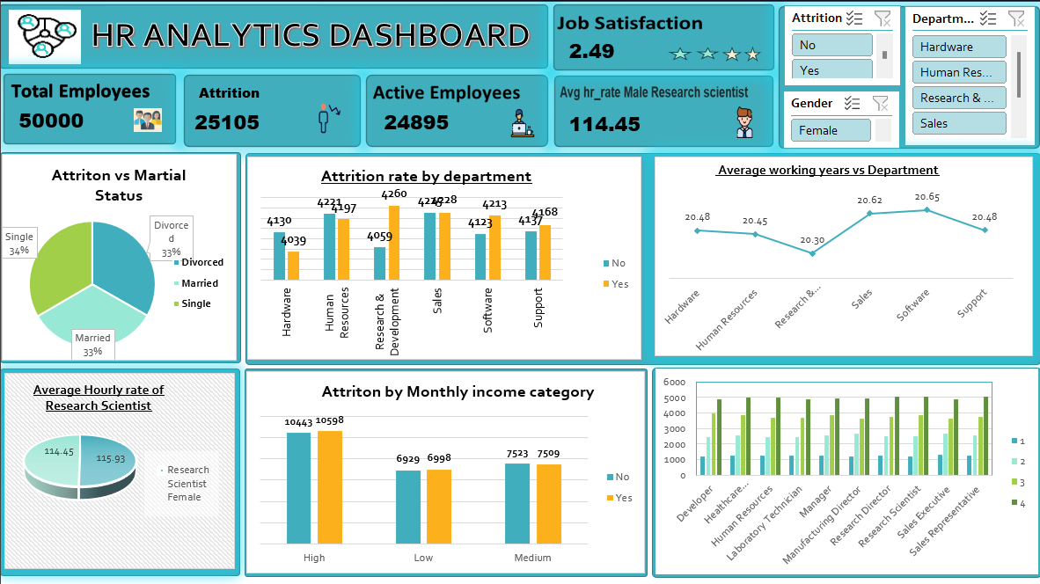
Excel Dashboard

Slide 11
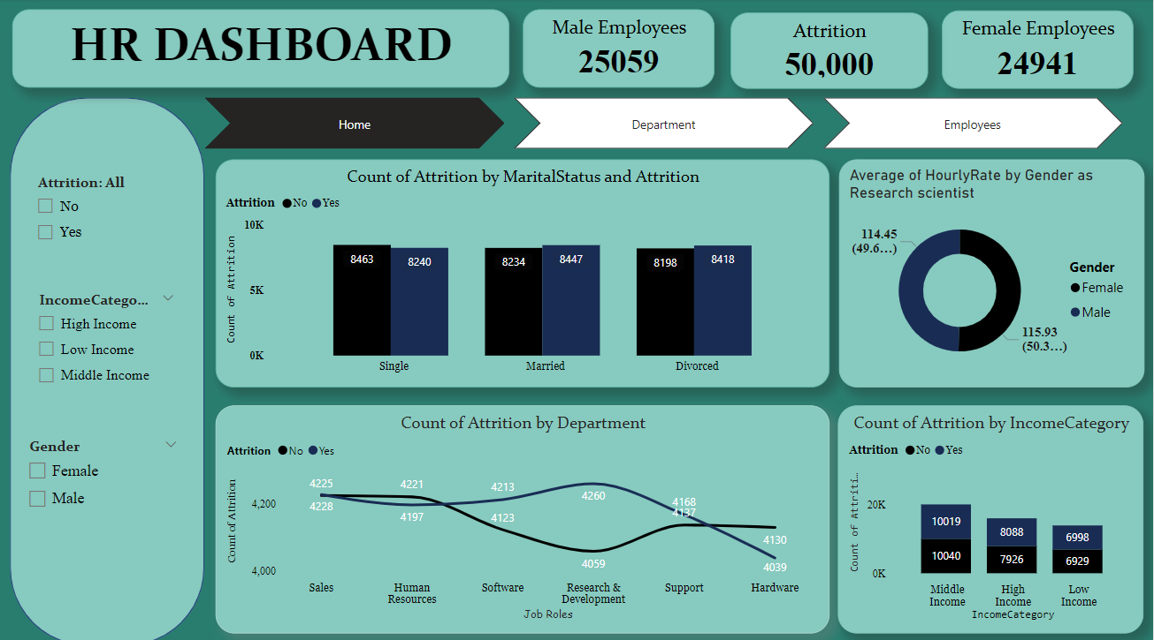
Power BI Dashboard

Slide 12
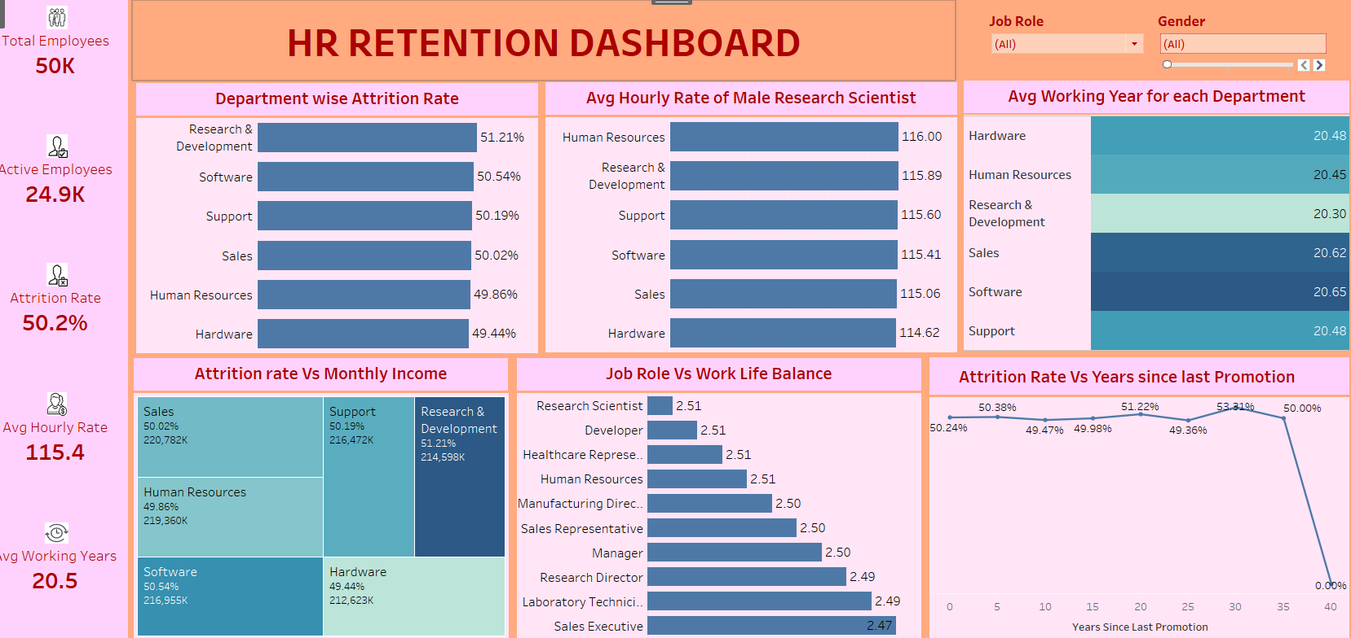
Tableau Dashboard

Slide 13
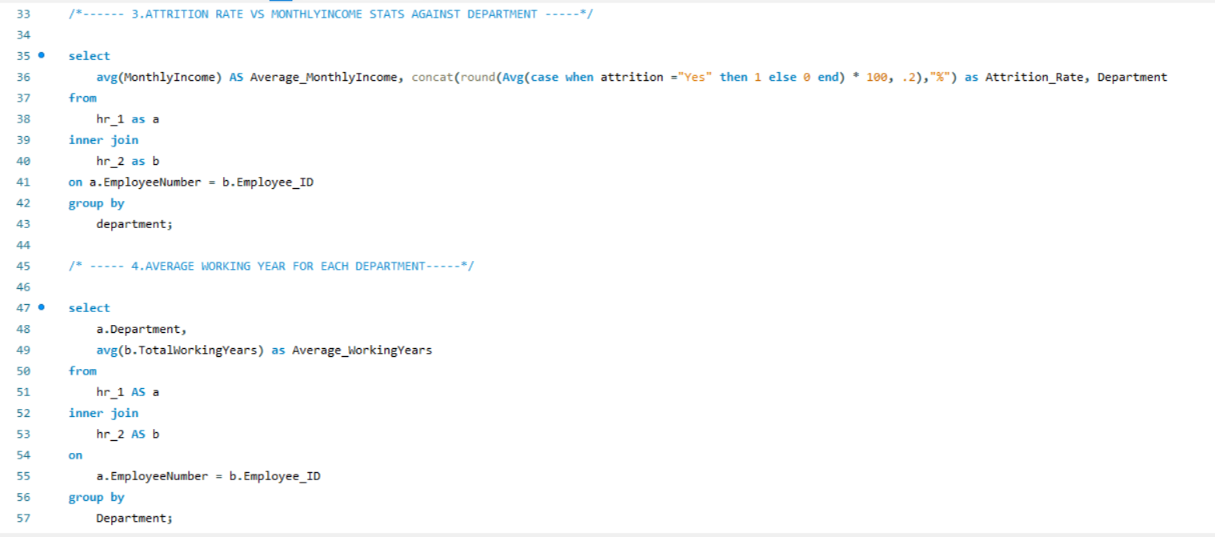
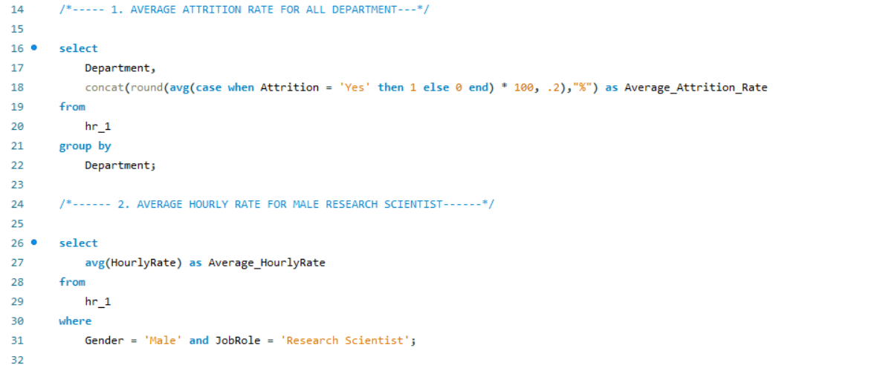
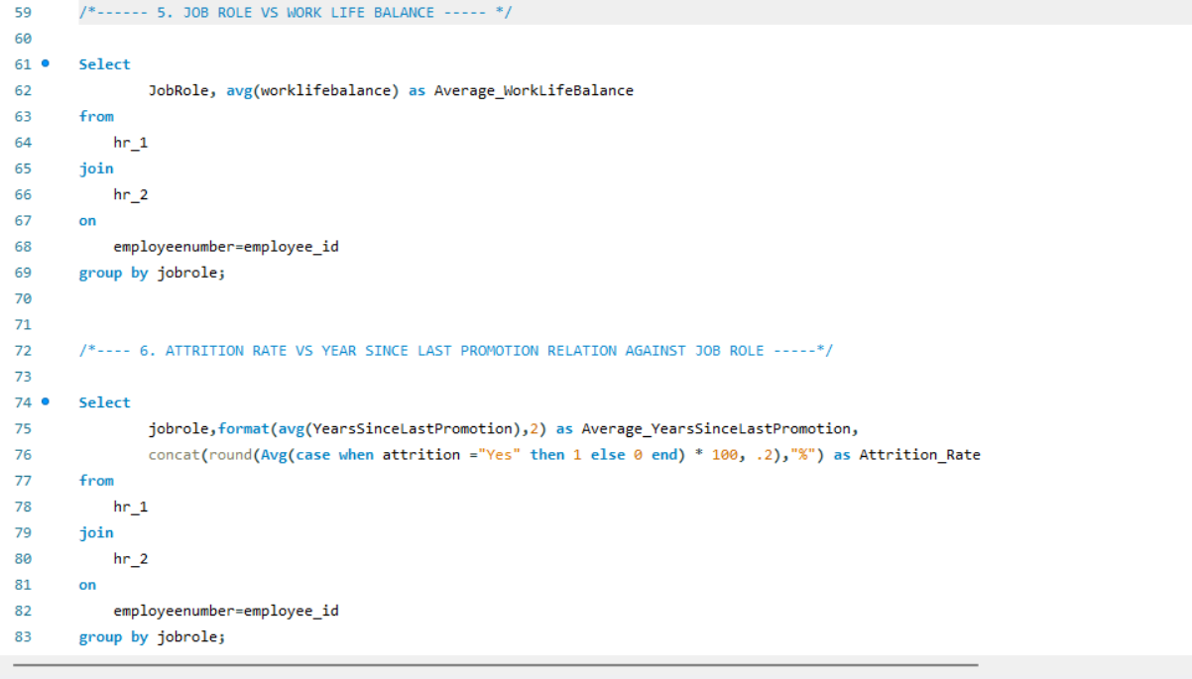

Slide 14
Conclusion
Summary :
Attrition and dissatisfaction are critical challenges.
Targeted interventions in high-risk areas can drive improvement.
A balanced focus on satisfaction, leadership, and culture is essential.
Call to Action :
Implement proposed solutions immediately to reduce attrition and enhance engagement.

Slide 15


